Slide 1
Hill Cipher
Nirmal K
CB.EN.U4CSE19038
Notes:
We’ll be looking into the hill cipher today, which is used to encrypt and decrypt strings using some cool logic.

Slide 2
Encryption
1

Slide 3
Logic
A = 0
B = 1
C = 2
D = 3
E = 4
.
.
.
Z = 25
Linear Algebra
Substitution ->
Notes:
The hill cipher is based on linear algebra, and to achieve the same it functions by allotting every character a corresponding number. Although not necessarily the only form of implementing this, we can assume that the numbers 1 to 26 map to the 26 English letters.

Slide 4


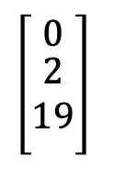
Logic
Message
Key
ACT
Length n = 3
GYBNQKURP
$$\left[\begin{matrix}0 \\ \begin{aligned}2 \\ 19\end{aligned} \\ \end{matrix}\right]$$
Key
Computers
Notes:
We begin by choosing a key such that it can be used to form a matrix of nXn where n is the length of the message. Let’s choose our message as act and the key as GYBNQKURP, 3 and 9 characters respectively. We then convert the strings into their corresponding numerical forms by substituting them. I was using the draw shapes and convert to shape feature on powerpoint and it refused to generate a row so please imagine the numbers are arranged in a row for key.Now let’s do the same thing for the key, we convert. Computers into an nXn matrix.

Slide 5
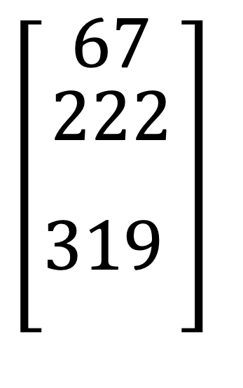
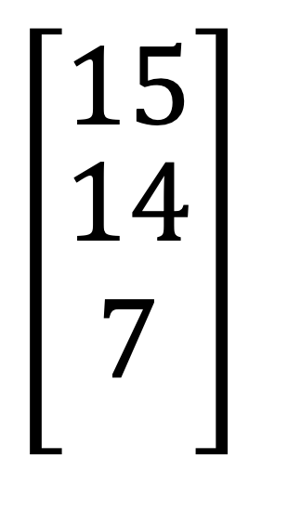
Logic
$$\left[\begin{aligned}67 \\ \begin{aligned}222 \\ 319\begin{matrix} \\ \\ \end{matrix}\end{aligned}\end{aligned}\right]$$
$$\left[\begin{matrix}15 \\ \begin{aligned}14 \\ 7\end{aligned} \\ \end{matrix}\right]$$
mod 26
Notes:
Now, we multiply the two matrices. Now take modulus of this number by 26. We have numbers that all represent a character, and by noting these characters we have our ciphertext. It is ‘drp’

Slide 6
Logic
P O H
Notes:
The final cyphertext is QAV.

Slide 7
Decryption
2

Slide 8

Logic
Reverse the process
Multiply cipher by inverse of key

Slide 9



Logic

